Slide 1
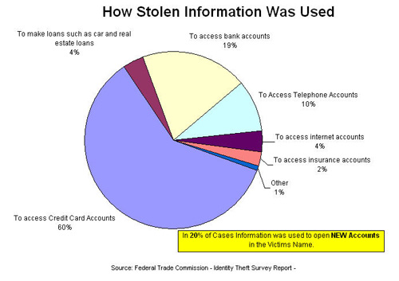
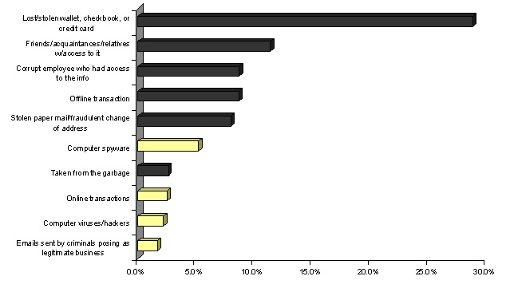
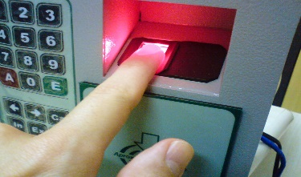

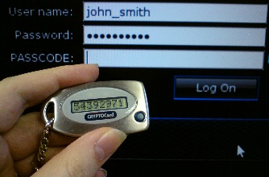
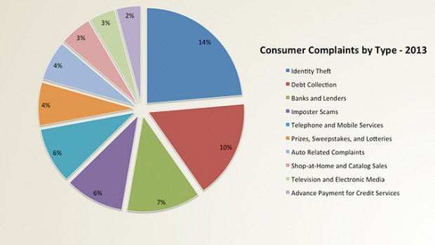

Scientific Poster on Identity Theft 220CT COURSEWORK 2016 VENELIN DIMITROV SID - 6297262
INTRODUCTION As people living in the information age we are required to use internet daily. That means we are visiting different kinds of websites daily, which for some we are unaware of their origins but we can easily be lured into giving personal information in order to access them and view their content. Many have security protections for users and every detail which was input is stored in a hash key on a server and is unreadable to administrators. But the treat of being scammed is not only in the virtual space and in fact the graph below shows that it is more common your security to be breached
There are pages which collect data, information and even sometimes personal records and have the power to sell it to other media or government authorities for personal gain. This is also possible of happening through personal mail, shopping discount cards or street surveys. In those sheets you are required to input your names, address, age, date of birth which are then copied down to servers of the company doing the research. The big data is then sold or even in some cases given for free to other companies for research or advertisement.
PREVENTION All of this can be prevented when being extra cautious with who you are sharing your information. For example online services, banks, job agencies and other will ask for your Insurance number but they don’t actually need it. You can leave it blank and only fill it in if they can explain to you why it is needed in the application form. - Don’t use the same password for all your account, avoid easily guessed PINs, - Beware of phishing scams like your bank or other competitor bank sending an email to confirm your password and your card through email, false lottery win or Nigerian royalty offering you free cash. - Always delete your data or if possible destroy the storage for any device you wish to sell second hand or just throw out in the garbage. There are tech-savvy people which can gather the information which was stored and even deleted at some point. - If shopping online, use a card only for internet purchases, never store your details in websites even if it’s convenient and always check if the site is legitimate and it has the security symbols for encryption. - If you suddenly start to receive a lot of junk mail from different stores means your address and name have been sold from the market you have registered for other competitors. You can always sign up for these services with fake information or just use prepaid card which can be bought almost in every store. - If you want to feel more secure with your bank account ask for personal confirmation number (PIN or BIC) card reader or applying for monitoring with a small monthly cost. And probably in the future biometrical banking with fingerprints and retina scanners.
CONCLUSION Identity theft has become a fact of everyday life for each person. To avoid becoming a victim, protect your personal information, monitor your accounts and respond rapidly to any signs your identity is being misused. In conclusion people are still not familiar with how most of the technology works. Local banks, supermarkets and job agencies sometimes will not provide the necessary security. Businesses are driven by getting more and more income even if sometimes selling your information to third parties which are just names and dates but those could be used in many ways to harm or just minor commercial spam. Every person has to be cautious and curious if his data is going to be used by any way of the authority or if not why it is required providing.
METHODS There are numerous cases in the US where fraudsters only having the “Social Security Number” of a person can candidate for a loan from a bank and get approved. It was even possible for deceased people to go into debt but since then the government acquired an SSN randomization and stopped sharing the big data daily on their website which was public for everyone to see and mostly used by criminals and hackers and not by many users. Scammers can get the rest of the data through sites collecting that info from companies for small amount of payment, or phone calls pretending to be the victim to different places he was subscribed. Other methods are: - Dumpster Diving for documents - Fishing for important mail in mailboxes - Employment scams - Diverting your billing address directly to them - Skimming with a device on ATMs, which records all the data of the card on a device Once they have all your information gathered they can drain your bank account, run up charges on your credit cards , get medical treatments, file a tax refund in your name even in some extreme cases a thief might even give your name to the police during an arrest.
The graph on the right shows, the main reasons for customers to be unsatisfied with a service highest percentage is because of the amount of information given by them to the company and not being really sure how it is being handled afterwards.
REFERENCES www.identitytheft.org.uk www.pensierocritico.eu/profilazione-identita-digitale.html www.truthinadvertising.org/id-theft-tops-complaints-2013
VENELIN DIMITROV

